Slide 1
Operating System(22516) Unit 2 : Services & Components of Operating System Marks: 10
Prepared by:
Mrs. Kousar Ayub A.
Lecturer(Selection Grade)
Computer Engg. Dept
M. H. Saboo Siddik Polytechnic

Slide 2
Learning Outcomes
Services of OS
System Calls
OS Components
Use of Operating System Tools

Slide 3
Services of OS
Services for the user
Program execution – system capability to load a program into memory and to run it.
I/O operations – since user programs cannot execute I/O operations directly, the operating system must provide some means to perform I/O.
File-system manipulation – program capability to read, write, create, and delete files.
Communications – exchange of information between processes executing either on the same computer or on different systems tied together by a network. Implemented via shared memory or message passing.
Error detection – ensure correct computing by detecting errors in the CPU and memory hardware, in I/O devices, or in user programs.

Slide 4
Services of OS(Cont…)
Services for OS itself
Resource allocation – allocating resources to multiple users or multiple jobs running at the same time.
Accounting – keep track of and record which users use how much and what kinds of computer resources for account billing or for accumulating usage statistics.
Protection – ensuring that all access to system resources is controlled.

Slide 5
System Calls
System calls provide the interface between a running program and the operating system.
Generally available as assembly-language instructions.
Languages defined to replace assembly language for systems programming allow system calls to be made directly (e.g., C, C++)
Three general methods are used to pass parameters between a running program and the operating system.
Pass parameters in registers.
Store the parameters in a table in memory, and the table address is passed as a parameter in a register.
Push (store) the parameters onto the stack by the program, and pop off the stack by operating system.

Slide 6
Example of open System Calls

Slide 7
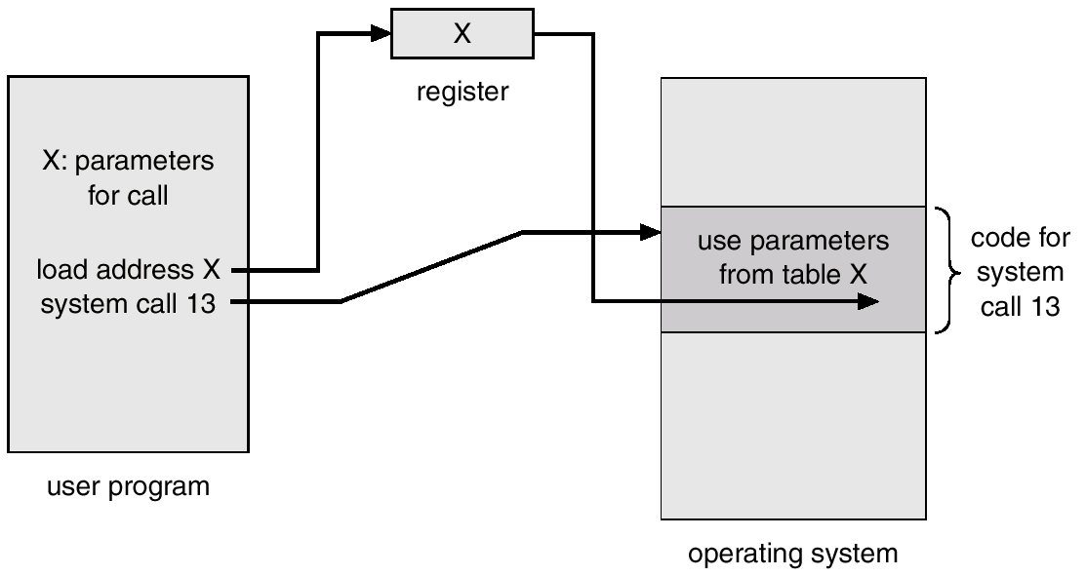
Passing of Parameters As A Table

Slide 8
Types of System Calls
Process control
File management
Device management
Information maintenance
Communications

Slide 9
OS Components
Process Management
Main Memory Management
File Management
I/O System Management
Secondary Management

Slide 10
Structure of UNIX operating system

Slide 11
Process Management
A process is a program in execution. A process needs certain resources, including CPU time, memory, files, and I/O devices, to accomplish its task.
The operating system is responsible for the following activities in connection with process management.
Process creation and deletion.
process suspension and resumption.
Provision of mechanisms for:
process synchronization
process communication

Slide 12
System Calls related to Process control are
End, Abort
Load, Execute
Create process, Terminate process
Ready process, Dispatch process
Suspend process, Resume process
Get process attributes, Set process attributes
Wait for Time
Wait event, Signal event
Change priority of process

Slide 13
Main-Memory Management
Memory is a large array of words or bytes, each with its own address. It is a repository of quickly accessible data shared by the CPU and I/O devices.
Main memory is a volatile storage device. It loses its contents in the case of system failure.
The operating system is responsible for the following activities in connections with memory management:
Keep track of which parts of memory are currently being used and by whom.
Decide which processes to load when memory space becomes available.
Allocate and deallocate memory space as needed.

Slide 14
File Management
A file is a collection of related information defined by its creator. Commonly, files represent programs (both source and object forms) and data.
The operating system is responsible for the following activities in connections with file management:
File creation and deletion.
Directory creation and deletion.
Support of primitives for manipulating files and directories.
Mapping files onto secondary storage.
File backup on stable (nonvolatile) storage media.

Slide 15
System Calls related to File Managememt are
Create file, Delete file
Open a file, Close a file
Create directory
Read, Write, Reposition
Get file attributes, Set file attributes
Create a link
Change working directory

Slide 16
I/O System Management
The I/O system consists of:
A buffer-caching system
A general device-driver interface
Drivers for specific hardware devices

Slide 17
Device Management
Files can be thought of as abstract or virtual devices. Thus many of the system calls for files are also needed for devices. If there are multiple users of the system however we must first request the device to ensure that we have exclusive use of it. After we are finished with the device, we must release it. These functions are similar to the open/close system calls for files.
Once, the device has been requested we can read, write and reposition the device just as with files. In fact the similarity between input/output devices and files is so great that many operating systems merge the two into a combined file/device structure. In this case input/output devices are identified by special file names

Slide 18
System Calls related to device Management
Request device, Release device
Read, Write, Reposition
Get device attributes, Set device attributes

Slide 19
Information Maintenance
Many system calls exist simply for the purpose of transferring information between the user program and the operating system. For example most systems have a system call to return the current time and date. Other system calls may return information about the system such as the number of current users, the version number of the operating system, the amount of free memory or disk space and so on.
In addition the operating system keeps information about all of its jobs and processes and there are system calls to access this information. Generally, there are also calls to reset it. (get process attributes and set process attributes).

Slide 20
System Calls related to Information Maintenance
Get Time or Date, Set Time or Date
Get system Data, Set system Data
Get process, File or Device attributes
Set process, File or Device attributes

Slide 21
Secondary-Storage Management
Since main memory (primary storage) is volatile and too small to accommodate all data and programs permanently, the computer system must provide secondary storage to back up main memory.
Most modern computer systems use disks as the principle on-line storage medium, for both programs and data.
The operating system is responsible for the following activities in connection with disk management:
Free space management
Storage allocation
Disk scheduling

Slide 22
System Programs
System programs provide a convenient environment for program development and execution. The can be divided into:
File manipulation
Status information
File modification
Programming language support
Program loading and execution
Communications
Application programs
Most users’ view of the operation system is defined by system programs, not the actual system calls.

Slide 23
User Management
User Management: As the administrator, it is your job to create and manage the accounts for all required users. Linux comes with several tools for user management. User management includes everything from creating a user to deleting a user on your system.
Following are the Linux command line tools for managing users and groups:
1. useradd.
2. usermod.
3. userdel.
Useradd: Creating New User: To add new users in Linux system we can use useradd command.
Syntax: useradd login_name
Example: useradd mhssp

Slide 24
User Management
passwd Command: The passwd command is used to set up passwords for users.
Syntax: password user_name
Example: $ passwd mhssp
Changing password for mhssp:
(current) UNIX password: 123 45
Enter new UNIX password: abc@123
Retype new UNIX password: abc@123
passwd: password updated successfully

Slide 25
User Management
Usermod: Modifying Properties of User: The command usermod is used to modify the properties of an existing user.
Syntax: usermod -c <'newName'> <oldName>
Userdel: Delete a user account: To delete a user account userdel command is used.
Syntax: userdel -r <userName>

Slide 26
Security Policy
Following are the best practices for securing linux os Keep System Updated: Always keep system updated with latest releases patches, security fixes and kernel when it’s available.
$ yum updates
$yum check-update
Use Secure SSH: Telnet and rlogin protocols uses plain text, not encrypted format which is the security breaches. SSH is a secure protocol that use encryption technology during communication with server. Never login directly as root unless necessary. Use “sudo” to execute commands.
$ vi /etc/ssh/sshd_config
$ PermitRootLogin no #disable root login
$AllowUsers username # Allow only specific users
$ Protocol 2 #use SSH protocol 2 version
Lock and Unlock Features: They are very useful, instead of removing an account from the system, you can lock it for an week or a month. To lock a specific user, you can use the follow command.
$ passwd -1 accountname

Slide 27
Security Policy
Turn Off IPv6: If you are not using a IPv6 protocol, then you should disable it because most of the applications or policies not required IPv6 protocol and currently it doesn’t required on the server. Go to network configuration file and add followings lines to disable it.
# vi /etc/sysconfig/network
NETWORKING_IPV6=no
IPV6INIT=no
Enables Iptables (Firewall): It is highly recommended to enable Linux firewall to secure unauthorised access of your servers. Apply rules in iptables to filters incoming, outgoing and forwarding packets. We can specify the source and destination address to allow and deny in specific udp/tcp port number.
Use Strong Password Policy: Passwords are always a security problem because humans are. People often cannot be bothered to come up with a lot of different passwords, so they use the same ones in different places or combinations that are easy to remember, like “password” or “abcde”. Basically, a gift to hackers. Make it a requirement that any password must contain both upper and lower case, be a mix of numbers, letters and symbols and you’ll be way safer.

Slide 28
Security Policy
Install Antimalware/Antivirus Software: It is true that there are free anti-malware programs out there, but as you might expect you get what you pay for. Paid software means better programmers and greater safety. If your budget won’t stretch that far then consider using ClamAV and Maldet. These are open-source applications that do a good job of scouring your server for potential threats.
Backup Regularly.

Slide 29
Device Management
Device management is the process of managing the implementation, operation and maintenance of a physical and/or virtual device.
All Linux device files are located in the /dev directory, which is an integral part of the root (/) filesystem because these device files must be available to the operating system during the boot process. The device nodes in the /dev directory provide access to the corresponding kernel devices
Udev is the device manager for the Linux 2.6 kernel that creates/removes device nodes in the /dev directory dynamically. udev provides a persistent device naming system through the /dev directory, making it easier to identify the device.
Performance Monitor: It is really very tough job for every System or Network administrator to monitor and debug Linux System Performance problems every day.

Slide 30
Device Management
top Command: Linux top command is a performance monitoring program which is used frequently by many system administrators to monitor Linux performance and it is available under many Linux/Unix like operating systems. The top command used to display all the running and active real-time processes in ordered list and updates it regularly. It display CPU usage, Memory usage, Swap Memory, Cache Size, Buffer Size, Process PID, User, Commands and much more. It also shows high memory and CPU utilization of a running processes.
The top command is much useful for system administrator to monitor and take correct action when
required. COMMAND IS “$ top”

Slide 31
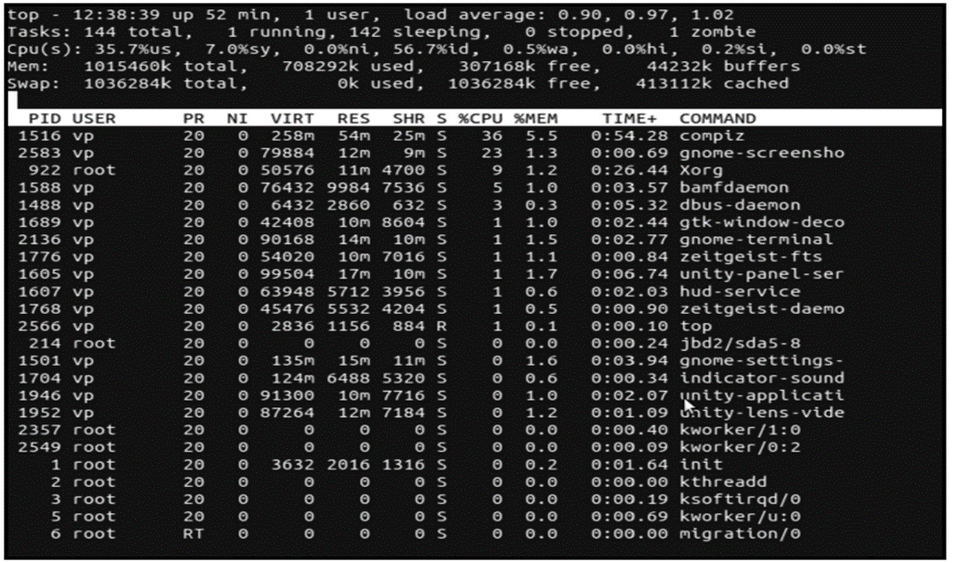
Device Management

Slide 32
Device Management
vmstat: Linux vmstat command used to display statistics of virtual memory, kernerl threads, disks, system
processes, I/O blocks, interrupts, CPU activity and much more.
Task Scheduler: Crontab files can be used to automate backups, system maintenance and other repetitive tasks. The syntax is powerful and flexible, so you can have a task run every fifteen minutes or at a specific minute on a specific day every year.

Slide 33
Thank you…..
You can mail your Queries to :
a2kousarj@gmail.com

